Slide 1
Welcome to
Cambourne Village College
Notes:
introduction and welcome

Slide 2
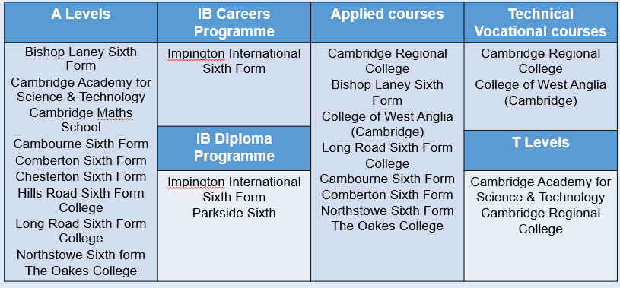
3. Post-16 choices Where can I study?
Additionally there are be non-CAP centres available.

Slide 4
Cambourne Village College Meet the SEN Team

Slide 5
Cambourne VC SEND Information
At Cambourne Village college there are:
64 pupils with an EHCP
6 EHCP applications pending
100 pupils on the SEN register
100 pupils identified with literacy difficulties

Slide 6
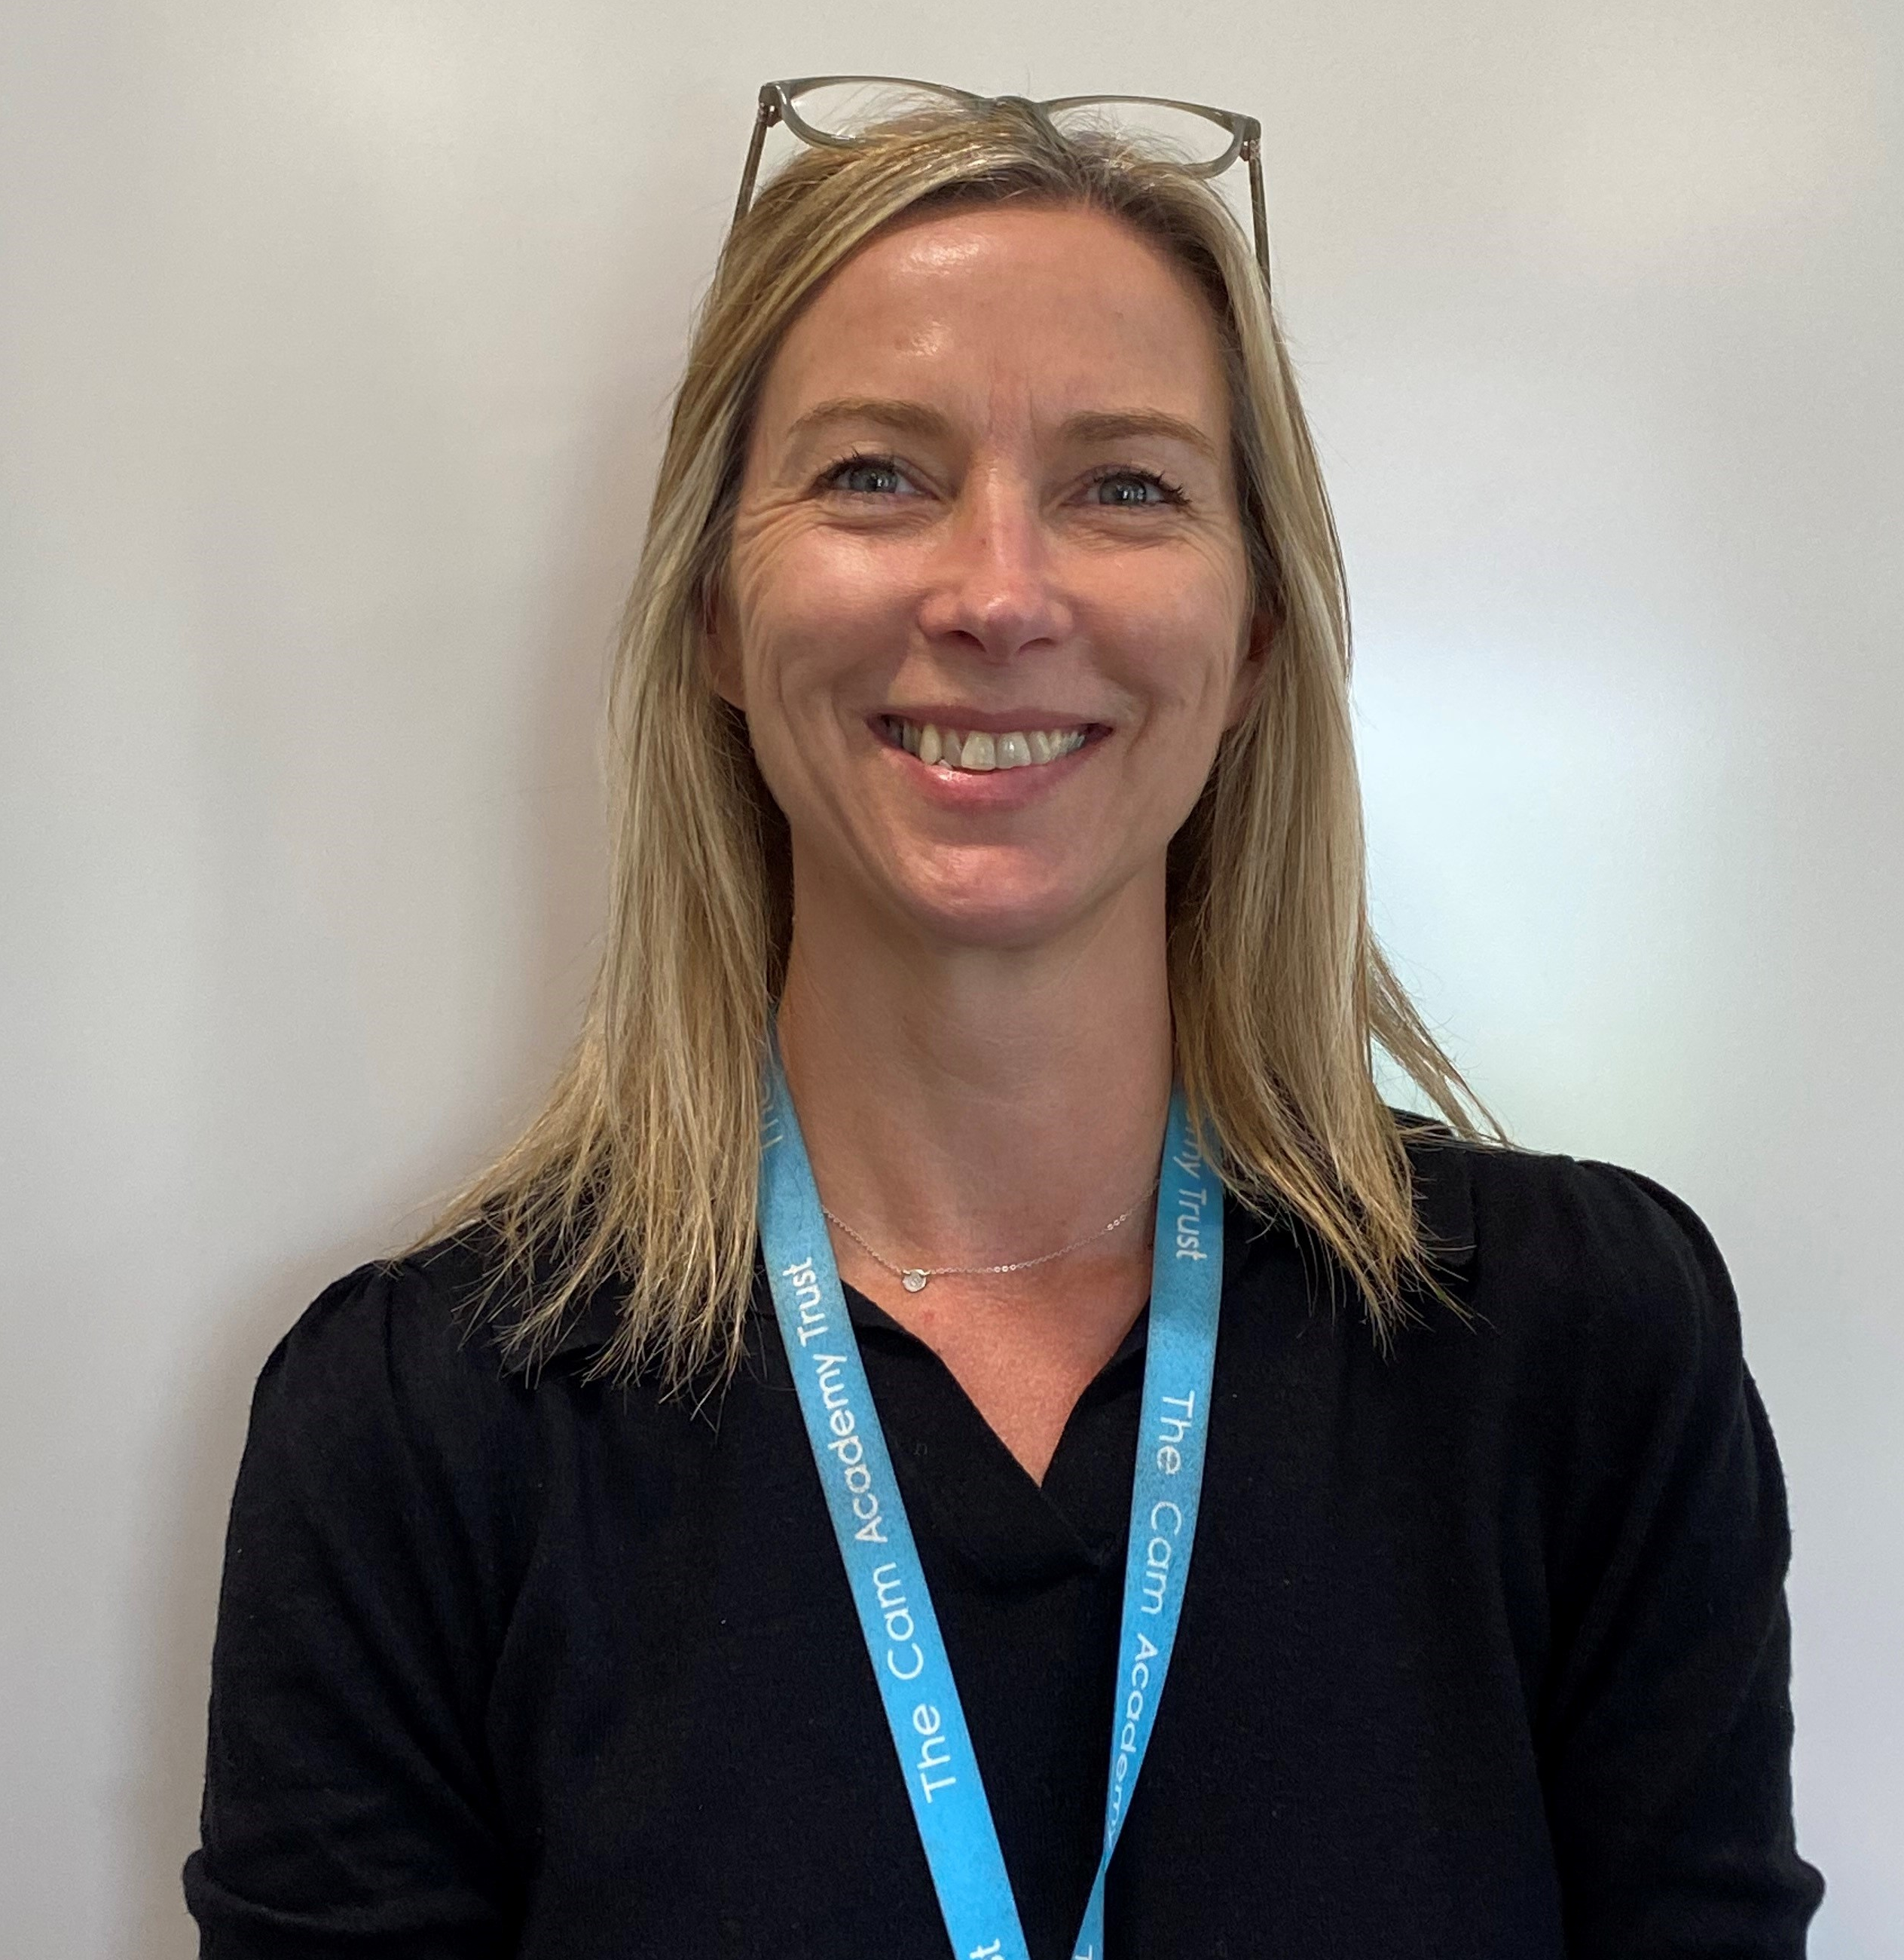
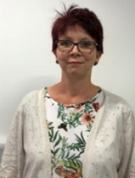
The Centre Team
Mrs Asplen
Centre Manager
Mrs Scott
SENCO
Miss McNeile
Assistant SENCO
Mrs Patman
Centre TA
Mrs Shaw
Assistant to SENCO
Mrs Hall
SEN Administrator

Slide 7
The Centre and SEND Support continued
All pupils will have a Form Tutor who will be your first point of contact – there will be a “Meet the Tutor” evening in September and your child will meet key staff members on the July transition days.
Pupils on SEN Support are supported in class through high quality teaching and overseen by the Year Team.
The Centre team generally support pupils with an EHCP. A child will only be awarded an EHCP if their needs are high, and a diagnosis does not automatically mean that an EHCP will be awarded.
Please allow time for your child to settle into secondary school. Staff members spend the first few weeks of term in lessons and getting to know your child.

Slide 8
What Is an Education, Health Care Plan?
An Education, Health and Care Plan or EHC/EHCP is a legal document which describes a child or young person’s Special Educational Needs and/or Disabilities (SEND).
An EHCP is written and provided by a Local Authority in order to give children and young people the help and support they need to make progress academically, socially and emotionally.
An EHCP replaced a Statement of Special Educational Need (SEN) when the revised Code of Practice was introduced in 2014.

Slide 9
Who Is an EHCP For?
An EHCP is for any child or young person that has a significant and complex Special Educational Need or Disability. An EHCP is required when a child’s needs cannot be met by the usual support that is available to them in their school or setting.
Many children with SEND receive support in their school or setting without an EHCP, however their support would come from resources already available within school. This is called SEN Support.
Following support at the SEN Support level, some children or young people’s needs may be deemed significant and complex and therefore require an EHC assessment by the Local Authority.

Slide 10
How Long Can a Child or Young Person Receive an EHCP?
An EHCP should provide support from birth up to the age of 25 in order to support with further education, training and support into the workplace.

Slide 11
How Can Parents or Carers Receive an EHCP for Their Child?
The first port of call for parents or carers is to speak to the school’s Heads of Year, if they have concerns about their child.
Year Teams will then liaise with the school SENCo.
Parents or carers can also contact their Local Authority and ask for an EHC assessment for their child. At this point, the Local Authority will review all evidence on a panel and make a decision whether to assess or not. If a decision is made to assess, at the end of that assessment period the LA will decide whether to issue an EHCP.

Slide 12
Information Sharing with the Wider School
All SEN information is uploaded to Bromcom and is accessible by all teaching and support staff.
EHCP information and strategy sheets are shared with relevant staff.

Slide 13
Literacy Difficulties
“10% of the population is believed to be dyslexic.” (British Dyslexia Association).
Literacy difficulties is the term used to cover pupils who face difficulties in reading, writing and comprehension.
If you have concerns regarding literacy difficulties, please contact your child’s English teacher in the first instance.
In September, all children complete a reading assessment and the English department compile a list of pupils identified as having literacy difficulties. This information is shared with teachers and after this your child may be offered a reading intervention.
Any advice we receive in a dyslexia report is mirrored in the strategy sheets we use and embedded within the high-quality teaching in lessons. Please note Cambridgeshire Local Authority do not fund dyslexia support in schools however the high-quality teaching ensures pupil needs are met.

Slide 14
Literacy Difficulties continued
As a school we encourage all KS3 students to continue handwriting in lessons where possible, as it is useful for revision methods and for exam preparation.
One of the most useful strategies to help your child progress in reading is to read every day with your child. It is important for students to apply comprehension strategies independently to other reading tasks and subjects and acquire the necessary skills for reading and understanding challenging texts (Education Endowment Foundation).
During primary school, your child may have had extra time in SATs this cannot be accommodated in termly tests at Secondary school due to lesson length, but teachers will take this into account for pupils.

Slide 15
Exam Access Arrangements
The SENCO completes exam access arrangements paperwork alongside the Exams Officer.
Legislation from the exam board means the earliest pupils are assessed for exam access arrangements is in Year 9.
In KS4, the school will need to provide substantial evidence that a pupil requires extra time in examinations and not all pupils will be granted extra time.
If the school have evidence that extra time is required, an external assessor (accredited by the exam board) will test your child to confirm what arrangements they are eligible for.
The exam access arrangements are then finalised and agreed by the exam board in Year 11.

Slide 16
ESOL / EAL Support at Cambourne Village College

Slide 17
What do we mean by EAL?
EAL means English as an Additional Language
EAL learners are defined as those who have been ‘exposed to a language at home that is known or believed to be other than English’ (Department for Education, 2019)
EAL is not seen as a measure of English language proficiency
EAL Learners may therefore be at any stage of developing English language proficiency - from new to English, to completely fluent

Slide 18
Supporting EAL students

Slide 19
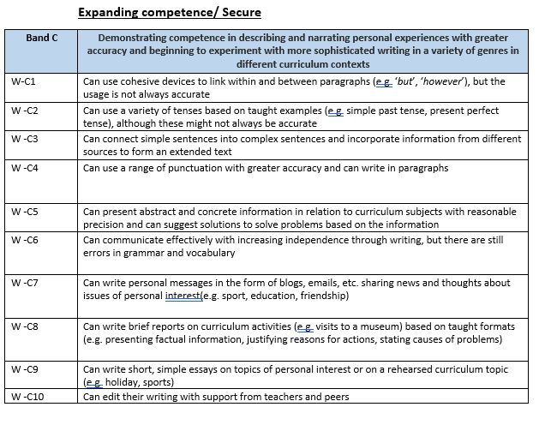
ESOL (English for Speakers of Other Languages) testing and teaching
A | New to English
B | Early Acquisition
C | Expanding Competence
D | Competent
E | Fluent

Slide 20
ESOL teaching
Students identified as Bands A and B are currently receiving 3 ESOL lessons per week
Students identified as Band C are receiving weekly Tutor Time interventions
Lessons focus on listening, reading, writing , speaking and grammatical accuracy

Slide 21
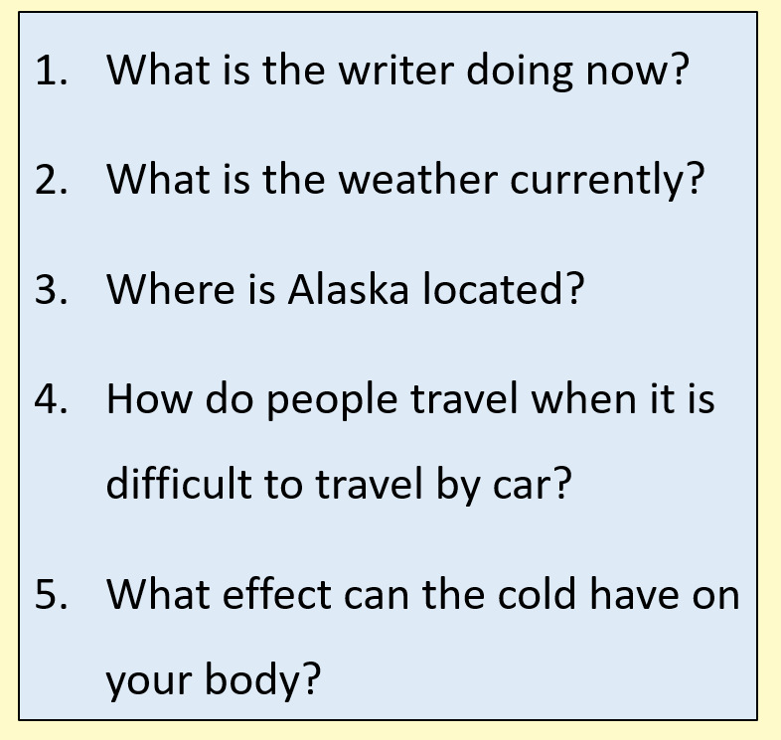

Slide 22
Wellbeing at CamVC
At Cambourne Village College we take the mental health and well-being of our community seriously. We believe that everyone should feel safe and happy when they are on our site, and we believe that well-being is fundamental to ensuring that each individual who makes up our community thrives.

Slide 23
What Support do we offer?
Tutor Teams Year Teams
Provisions Centre| Link| Blue Room | View| EAL| Counselling
Mentoring Teacher | Peer
Medical Room First Aid
Safeguarding

Slide 24
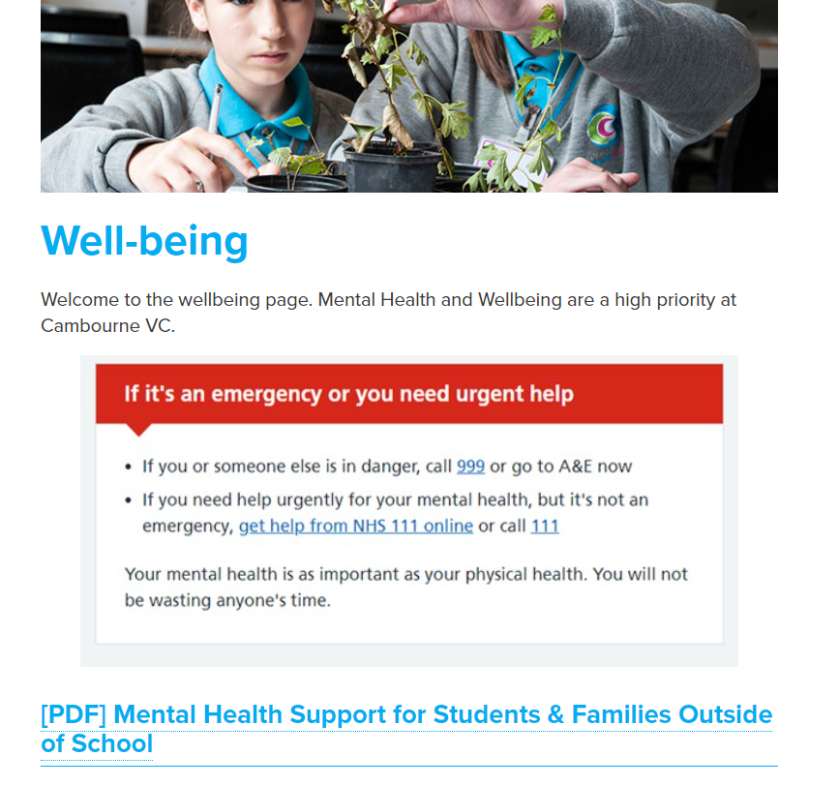
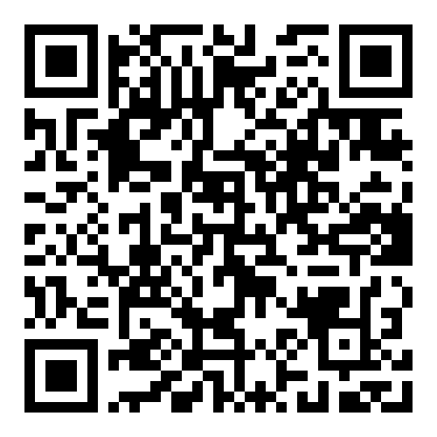
Outside of the School Day

Slide 25
15歲的子樂，在香港讀國際學校，兩文三語流利。2021年中隨父母來英，入讀私立學校，開課後一個月開始拒絕上學，每日跟香港的朋友網聊，至凌晨三、四時。
11歲的婷婷，母語是英文。2020年底入讀公立學校，數月後出現情緒問題，窗簾拉上，房間畫滿暗黑影像，質問媽媽為甚麼要帶她移民。
7歲的竣軒，移民前最愛笑，2021年初上學一個月後，老師跟家長說，他有創傷後遺症跡象，要儘快跟進。

Slide 26
https://hongkongwell.uk/zh/parents-faq/
由三位移英香港媽媽於2022年開始，至今已有80名義工，當中20位具心理治療背景或資歷，我們全部來自香港。
‧由前香港社工負責的諮詢服務，為家長解答相關問題
‧由註冊專業人士以廣東話替孩子做評估，並撰寫英語報告，方便NHS或學校跟進
‧資助少量廣東話輔導或治療服務
‧提供關於情緒管理及本地相關制度和服務的講座/工作坊；

